Slide 1
Unit-3 Linked List

Slide 2
Introduction – Linked list
Linked list is a linear collection of data elements.
These data elements are called nodes.
Every nodes in linked list contain two fields:
Data Field : stores the data
Pointer : contains the address of the next node in the list

Slide 3
Introduction – Linked list
The Left part of the node which contains data may include a simple data type, an array or a structure.
The Right part of the node contains a pointer to the next node (address of a next node in sequence).
The last node will have no next node connected to it so it will store a special value called NULL.
Thus NULL pointer denotes the end of the list.
In a linked list since every node contains a pointer to another node which is of the same type, it is called a self-referential data type.

Slide 4
Introduction – Linked list
A linked list contains a pointer variable called START, which stores address of first node in the list.
If START=NULL then it means that the linked list is empty and contains no nodes.
In C we implement a linked list using the following code:
struct node
{
int data;
struct node *next;
};

Slide 5
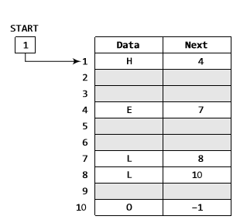
Introduction – Linked list
Following figure shows how a linked list is maintained in memory.
In order to form a linked list we need to have a structure called node that has two fields: DATA and NEXT.

Slide 6
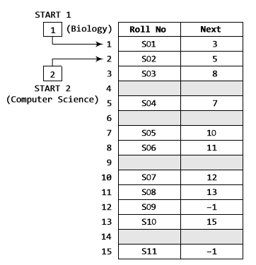
Introduction – Linked list
Two linked list can be maintained together in computer’s memory:

Slide 7
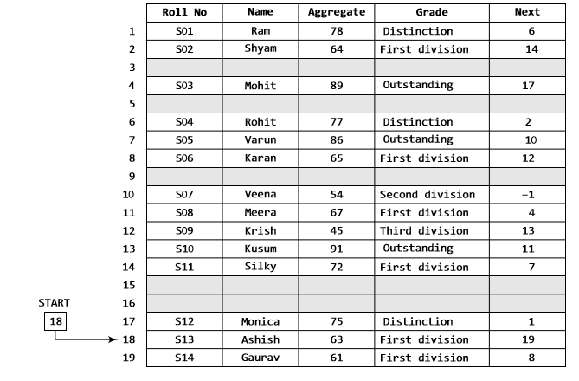
Introduction – Linked list

Slide 8
LINKED LISTS versus ARRAYS
Sr. No. | Arrays | Linked Lists
1 | An array is a collection of data elements. | A linked list is a linear collection of nodes (data elements + address of next data element).
2 | An Array stores its data elements in consecutive memory locations. | A Linked list doesn’t store its data elements in consecutive memory locations.
3 | Arrays are static. | Linked lists are dynamic.
4 | It is used for storing small amount of data. | It is used for storing large amount of data.

Slide 9
Memory Allocation And De-allocation For A Linked List
If a new node is to be added to an already existing linked list, firstly free space is found in the memory and then used to store the information.
Following figures show the scenario of memory before and after adding a new record.

Slide 10
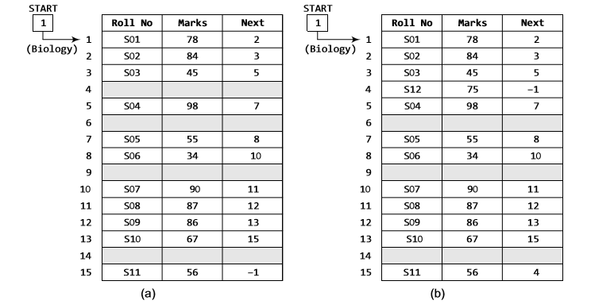

Slide 11
Memory Allocation And De-allocation For A Linked List
Which part of the memory is free and which is occupied is handled by Operating System.
The computer maintains a list of all free memory cells. This list of available space is called the free pool.
For free pool there is another pointer AVAIL which stores the address of the first free space .

Slide 12
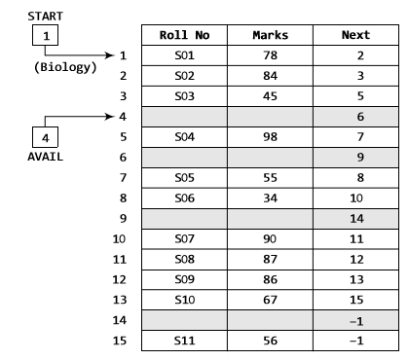

Slide 13
Types of Linked list
Following are the different types of linked lists that are going to be discussed throughout the chapter:
Singly Linked List
Circular Linked List
Doubly Linked List

Slide 14
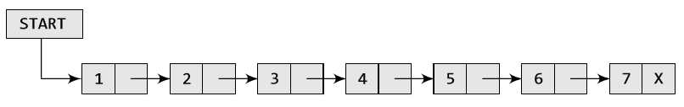
SINGLY LINKED LIST
The singly linked list is the simplest type of linked list in which each node contains data and a pointer to the next node of the same data type.
By saying that node contains a pointer to the next node means that the node stores address of the next node in the sequence.

Slide 15
Inserting A New Node In A Linked List
Inserting a new node is about to add a new node in an already existing linked list.
For insertion there are four cases:
Case 1: The new node is inserted at the beginning of a linked list.
Case 2: The new node is inserted at the end of a linked list.
Case 3: The new node is inserted after a given node.
Case 4: The new node is inserted before a given node.

Slide 16
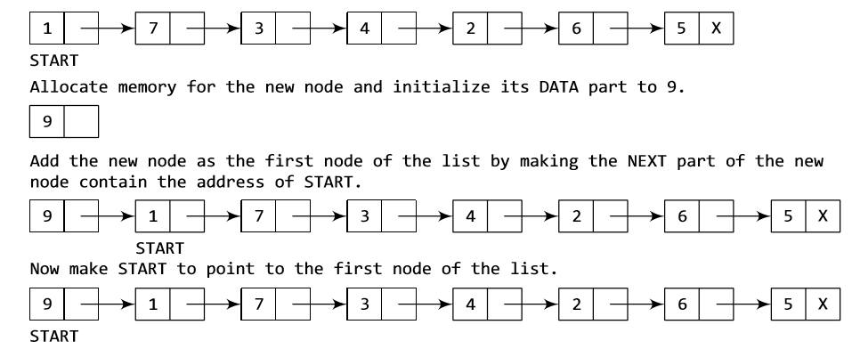
Case 1: At the beginning of the linked list

Slide 17
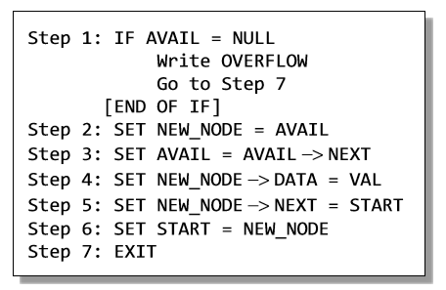
Case 1: At the beginning of the linked list
Algorithm to insert a new node at the beginning of a linked list:

Slide 18
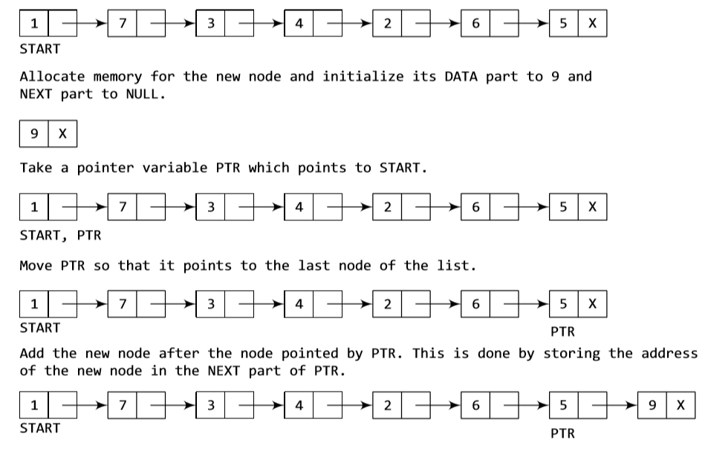
Case 2: At the end of the linked list

Slide 19
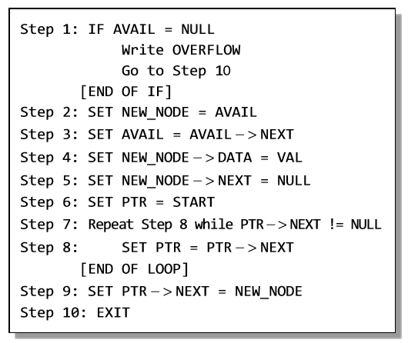
Case 2: At the end of the linked list
Algorithm to insert a new node at the end of a linked list:

Slide 20
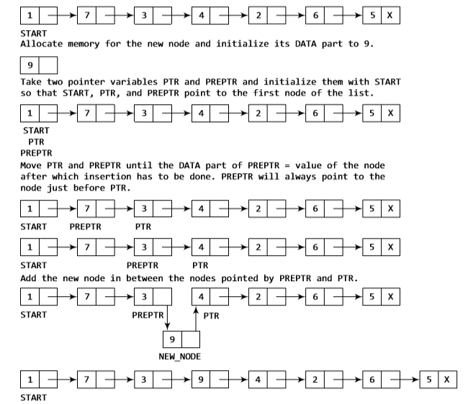
Case 3: After a given node

Slide 21
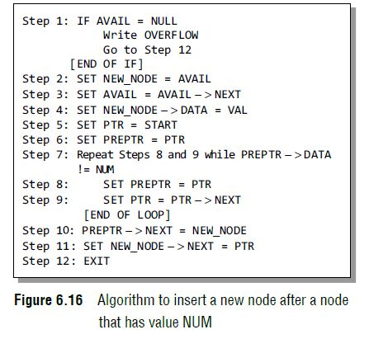
Case 3: After a given node
Algorithm to insert a new node after a node that has a value NUM:

Slide 22
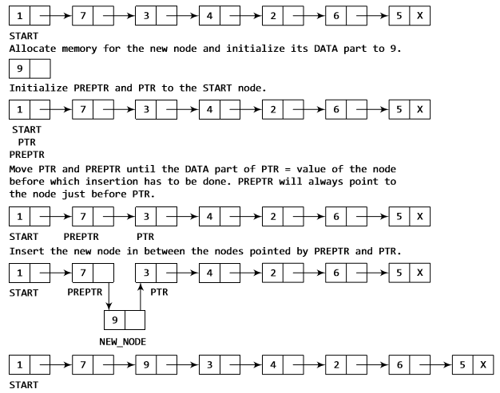
Case 4: Before a given node

Slide 23
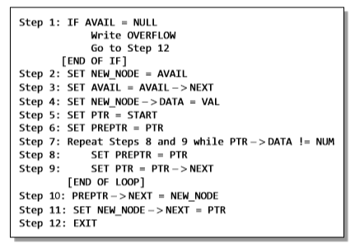
Case 4: Before a given node
Algorithm to insert a new node before a node that has a value NUM:

Slide 24
Deleting A New Node In A Linked List
Deleting a node is about removing a node from an already existing linked list.
For deletion there are four cases:
Case 1: The first node
Case 2: The last node
Case 3: Specific Node

Slide 25
Deleting A New Node In A Linked List
Before beginning with algorithms, first one important term is needed to be understood is- UNDERFLOW.
UNDERFLOW is a condition that occurs when we try to delete a node from a linked list that is empty.
This happens when START=NULL or when there are no more nodes to be deleted.
When we delete a node from the list, we have to free the memory occupied by that node.
This memory is returned to the free pool, so that it can be used to store other data.
Whatever be the case of deletion, we always change the AVAIL pointer so that it points to the address which has been recently freed.

Slide 26
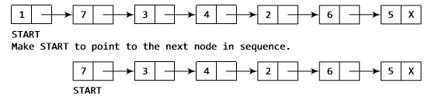
Case 1: First node

Slide 27
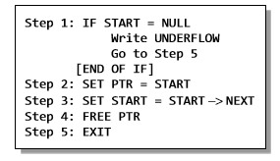
Case 1: First node
Algorithm to delete first node of a linked list:

Slide 28
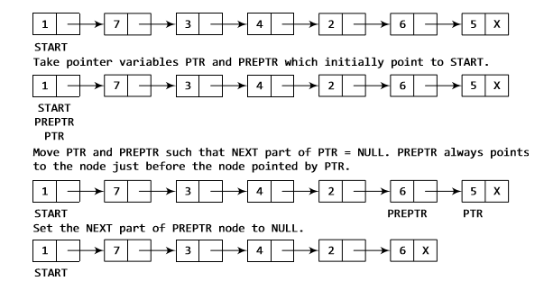
Case 2: Last node

Slide 29
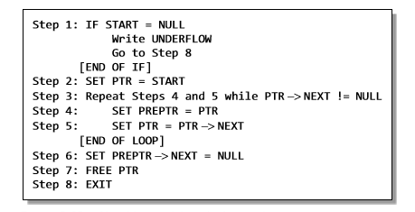
Case 2: Last node
Algorithm to delete last node of a linked list:

Slide 30
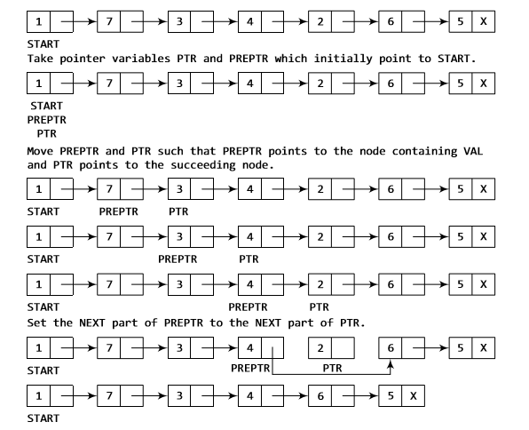
Case 3: Specific Node

Slide 31
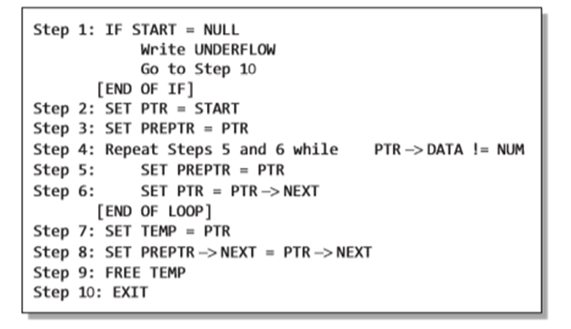
Case 3: Specific Node
Algorithm to delete a node after a given node in a linked list:

Slide 32
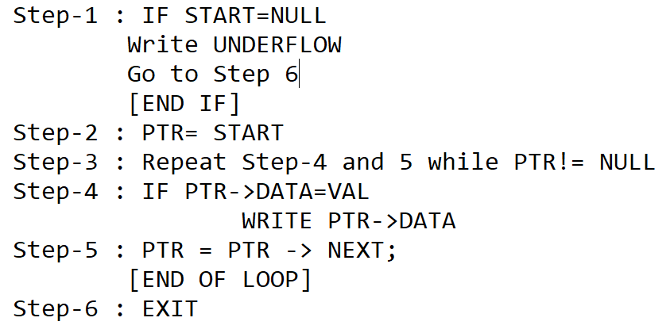
Search

Slide 33
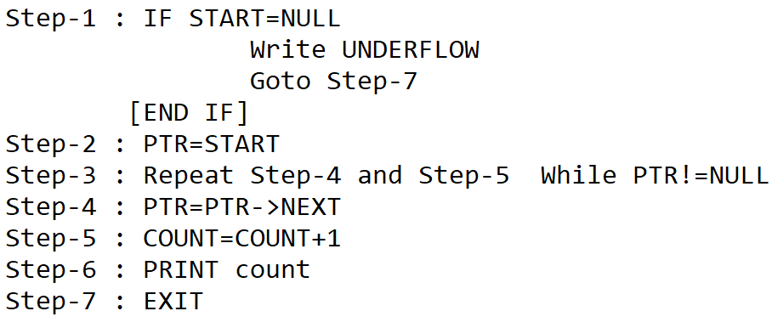
Count

Slide 34
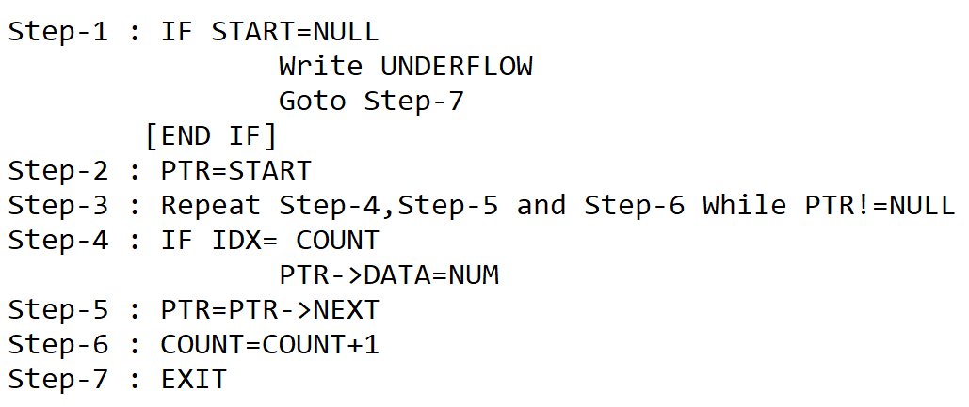
Update

Slide 35
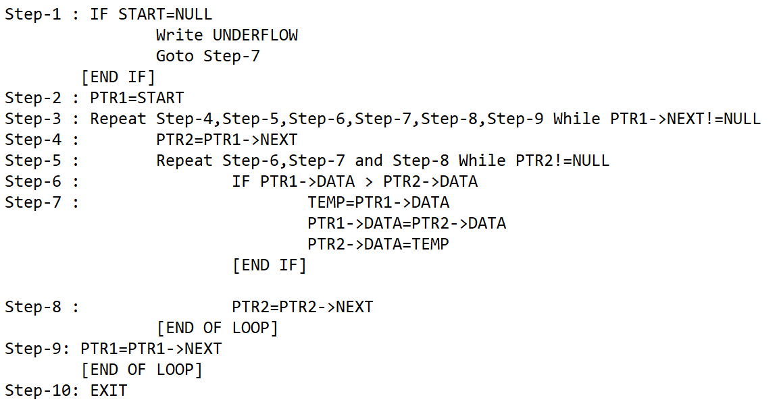
Sort

Slide 36
CIRCULAR SINGLY LINKED LIST
In a circular linked list, the last node contains a pointer to the first node of the list.
We can have a circular singly listed list as well as circular doubly linked list.
While traversing a circular linked list, we can begin at any node and traverse the list in any direction forward or backward until we reach the same node where we had started.
Thus, a circular linked list has no beginning and no ending.
START
1
2
3
4
5
6
7

Slide 37
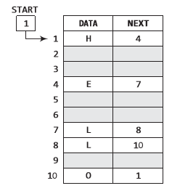
CIRCULAR SINGLY LINKED LIST
The node that contains the address of the first node is actually the last node of the linked list.
Memory representation of a circular linked list:

Slide 38
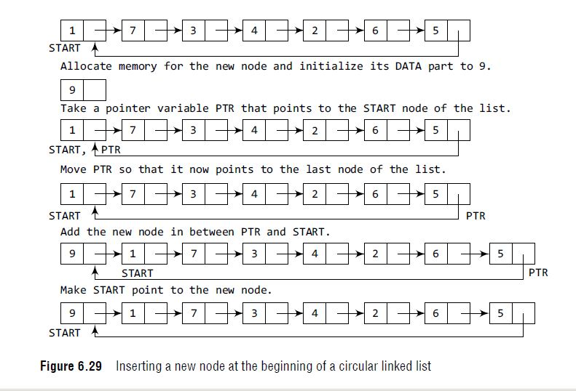
Case 1 : Inserting a new node at the beginning of the Circular Singly linked list

Slide 39
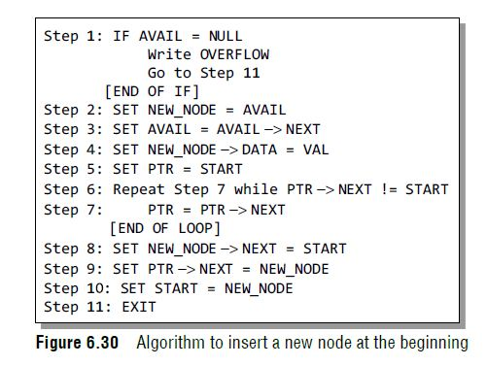
Case 1 : Inserting a new node at the beginning of the Circular Singly linked list

Slide 40
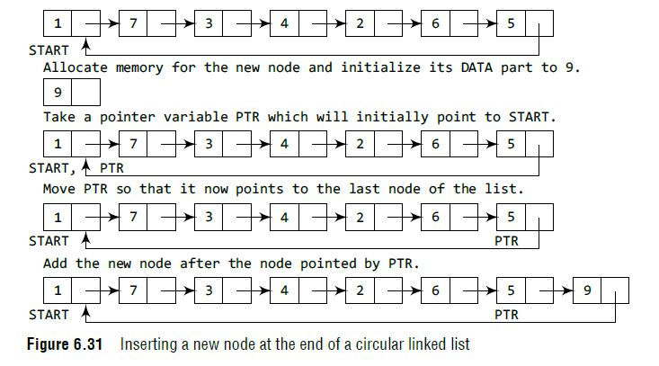
Case 2 : Inserting a new node at the end of the Circular linked list

Slide 41
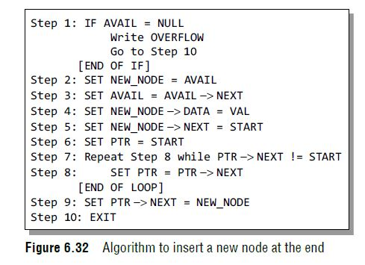
Case 2: Inserting a new node at the end of the Circular Singly linked list

Slide 42
Case 3: After a given node

Slide 43
Case 3: After a given node
Algorithm to insert a new node after a node that has a value NUM:

Slide 44
Case 4: Before a given node

Slide 45
Case 4: Before a given node
Algorithm to insert a new node before a node that has a value NUM:

Slide 46
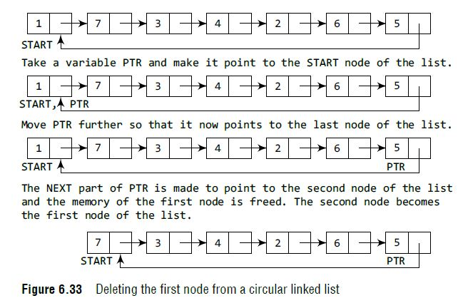
Case 1 : Deleting the first node of the Circular Singly linked list

Slide 47
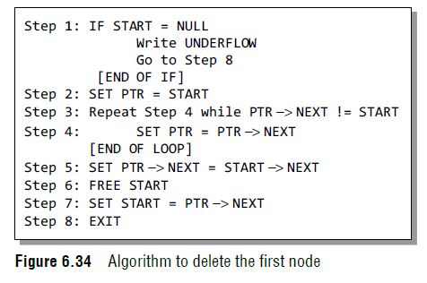
Case 1 : Deleting the first node of the Circular Singly linked list

Slide 48
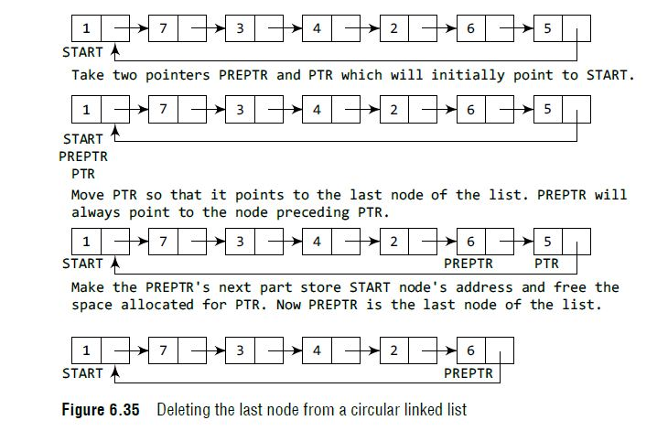
Case 2 : Deleting the last node of the Circular Singly linked list

Slide 49
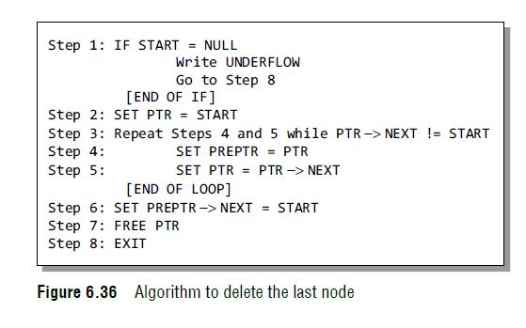
Case 2 : Deleting the last node of the Circular Singly linked list

Slide 50
Case 3: Specific Node

Slide 51
Case 3: Specific Node
Algorithm to delete a node after a given node in a linked list:

Slide 52

DOUBLY LINKED LIST
A Doubly Linked List or a two way linked list is a more complex type of linked list which contains a pointer to the next as well as previous node in the sequence.
Therefore, it consists of three parts and not just two.
The three parts are:
Data
A pointer to the next node
A pointer to the previous node

Slide 53
DOUBLY LINKED LIST
In C, the structure of a doubly linked list is as given below:
struct node
{ struct node *prev;
int data;
struct node *next;
};
The prev field of first node and the next field of last node contains NULL.
The prev field is used to store the address of preceding node. This would enable us to traverse the list in backward direction as well.

Slide 54
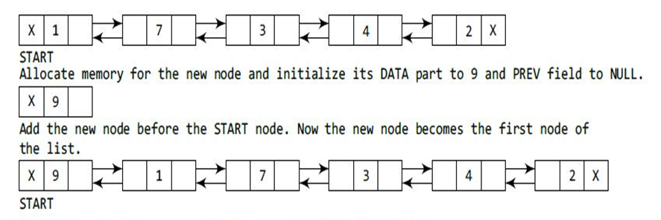
Inserting a New Node at the beginning of the Doubly Linked List

Slide 55
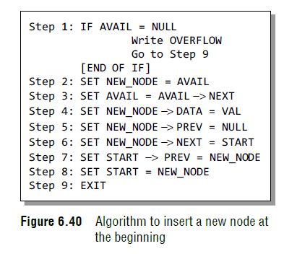
Inserting a New Node at the beginning of the Doubly Linked List

Slide 56
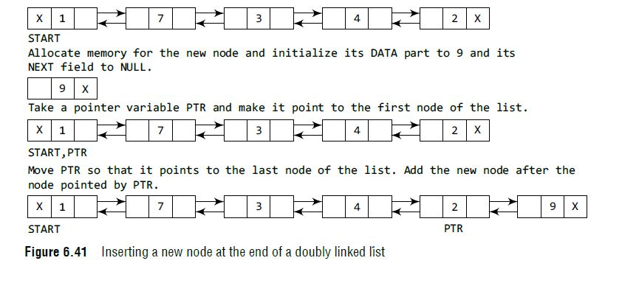
Inserting a New Node at the end of the Doubly Linked List

Slide 57
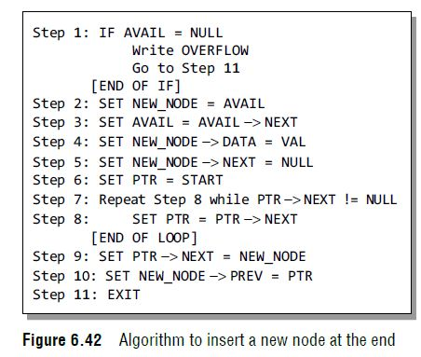
Inserting a New Node at the end of the Doubly Linked List

Slide 58
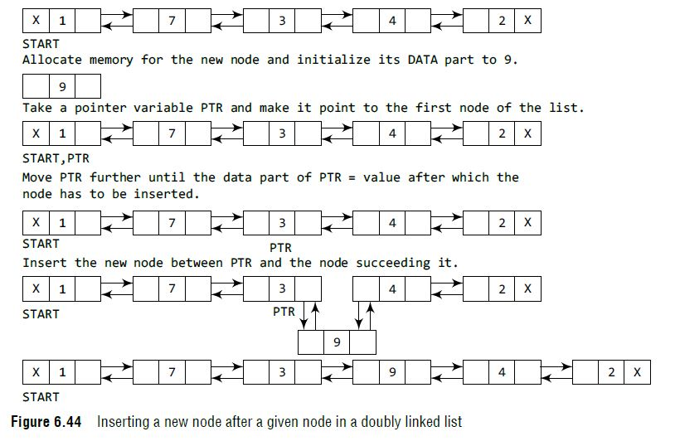
Inserting a New Node after the given node in the Doubly Linked List

Slide 59
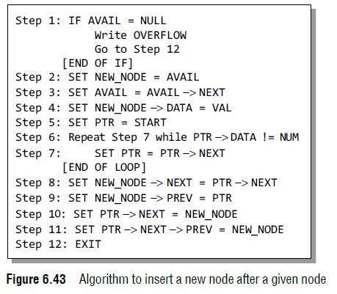
Inserting a New Node after the given node in the Doubly Linked List

Slide 60
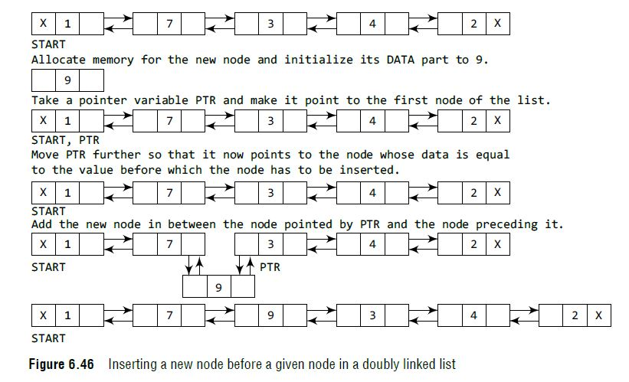
Inserting a New Node before the given node in the Doubly Linked List

Slide 61
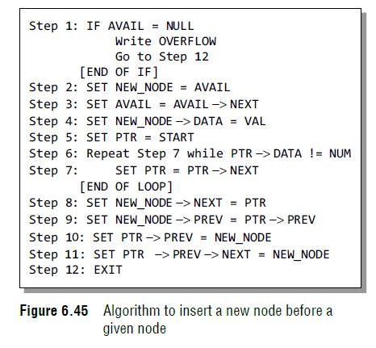
Inserting a New Node before the given node in the Doubly Linked List

Slide 62
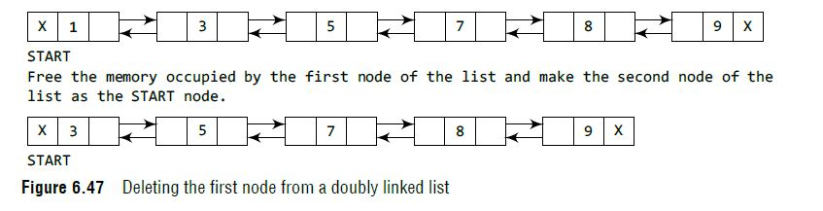
Deleting the first node of the Doubly linked list

Slide 63
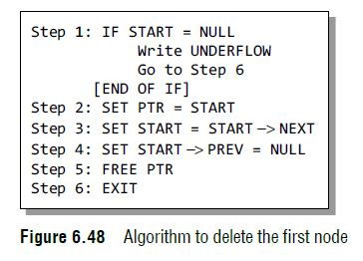
Deleting the first node of the Doubly linked list

Slide 64
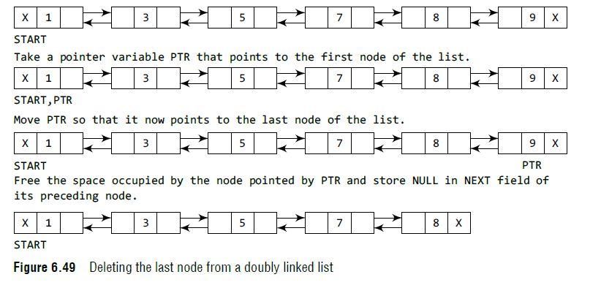
Deleting the last node of the Doubly linked list

Slide 65
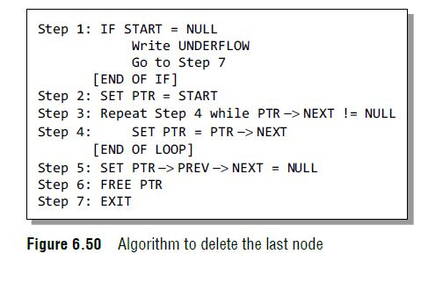
Deleting the last node of the Doubly linked list

Slide 66
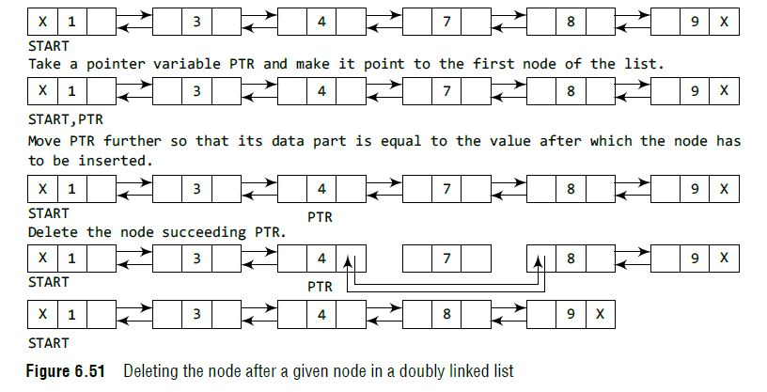
Deleting the specific node of the Doubly linked list

Slide 67
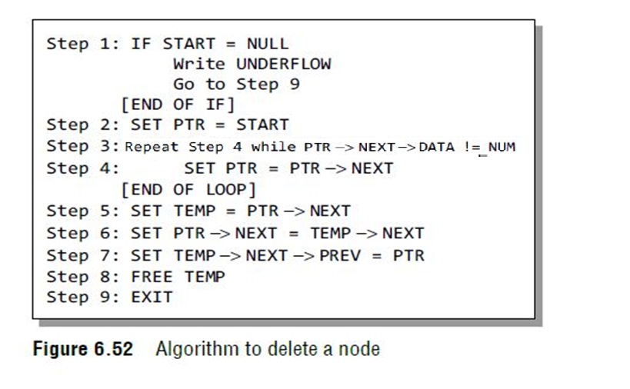
Deleting the specific node of the Doubly linked list

Slide 68
CIRCULAR DOUBLY LINK LIST
A circular doubly linked list or a circular two-way linked list is a more complex type of linked list which contains a pointer to the next as well as the previous node in the sequence. The difference between a doubly linked and a circular doubly linked list is same as that exists between a singly linked list and a circular linked list.
The circular doubly linked list does not contain NULL in the previous field of the first node and the next field of the last node. Rather, the next field of the last node stores the address of the first node of the list.

Slide 69
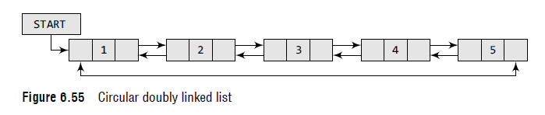
CIRCULAR DOUBLY LINK LIST

Slide 70
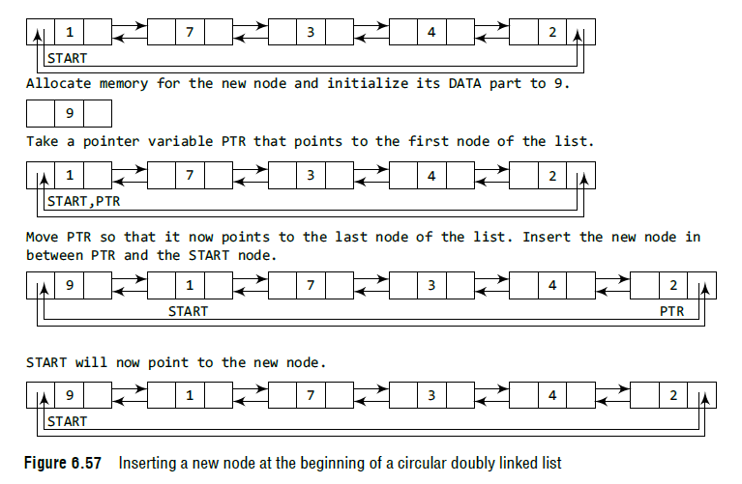
Inserting a Node at the Beginning of a Circular Doubly Linked List

Slide 71
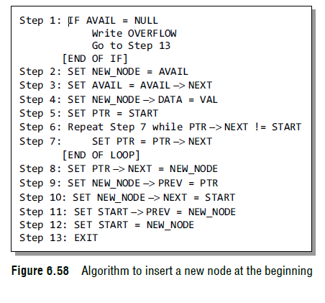
Inserting a Node at the Beginning of a Circular Doubly Linked List

Slide 72

Inserting a Node at the End of a Circular Doubly Linked List

Slide 73

Inserting a Node at the End of a Circular Doubly Linked List

Slide 74
Inserting a Node after the given node of a Circular Doubly Linked List

Slide 75
Inserting a Node before the given node of a Circular Doubly Linked List

Slide 76

Deleting the First Node from a Circular Doubly Linked List

Slide 77

Deleting the First Node from a Circular Doubly Linked List

Slide 78

Deleting the Last Node from a Circular Doubly Linked List

Slide 79

Deleting the Last Node from a Circular Doubly Linked List

Slide 80
Deleting the Specific from a Circular Doubly Linked List

Slide 81
STACK USING LINKED LIST
We have seen how a stack is created using an array. This technique of creating a stack is easy, but the drawback is that the array must be declared to have some fixed size.
In case the stack is a very small one or its maximum size is known in advance, then the array implementation of the stack gives an efficient implementation. But if the array size cannot be determined in advance, then the other alternative, i.e., linked presentation, is used.

Slide 82

STACK USING LINKED LIST
Push Operation
The push operation is used to insert an element into the stack. The new element is added at the topmost position of the stack. Consider the linked stack shown in Fig. 7.14.

Slide 83

STACK USING LINKED LIST
Push Operation
To insert an element with value 9, we first check if TOP=NULL. If this is the case, then we allocate memory for a new node, store the value in its DATA part and NULL in its NEXT part. The new node will then be called TOP. However, if TOP!=NULL, then we insert the new node at the beginning of the linked stack and name this new node as TOP. Thus, the updated stack becomes as shown in Fig. 7.15.

Slide 84

STACK USING LINKED LIST
Push Operation

Slide 85

STACK USING LINKED LIST
Pop Operation
The pop operation is used to delete the topmost element from a stack. However, before deleting the value, we must first check if TOP=NULL, because if this is the case, then it means that the stack is empty and no more deletions can be done. If an attempt is made to delete a value from a stack that is already empty, an UNDERFLOW message is printed. Consider the stack shown in Fig. 7.17

Slide 86

STACK USING LINKED LIST
Pop Operation
In case TOP!=NULL, then we will delete the node pointed by TOP, and make TOP point to the second element of the linked stack. Thus, the updated stack becomes as shown in Fig. 7.18.

Slide 87

STACK USING LINKED LIST
Pop Operation

Slide 88
QUEUE USING LINKED LIST
In case the queue is a very small one or its maximum size is known in advance, then the array implementation of the queue gives an efficient implementation. But if the array size cannot be determined in advance, the other alternative, i.e., the linked representation is used.

Slide 89
QUEUE USING LINKED LIST
INSERT Operation
To insert an element with value 9, we first check if FRONT=NULL. If the condition holds, then the queue is empty. So, we allocate memory for a new node, store the value in its data part and NULL in its next part. The new node will then be called both FRONT and rear. However, if FRONT != NULL, then we will insert the new node at the rear end of the linked queue and name this new node as rear. Thus, the updated queue becomes as shown in Fig. 8.8.

Slide 90

QUEUE USING LINKED LIST
INSERT Operation

Slide 91

QUEUE USING LINKED LIST
INSERT Operation

Slide 92

QUEUE USING LINKED LIST
DELETE Operation
To delete an element, we first check if FRONT=NULL. If the condition is false, then we delete the first node pointed by FRONT. The FRONT will now point to the second element of the linked queue. Thus, the updated queue becomes as shown in Fig. 8.11.

Slide 93

QUEUE USING LINKED LIST
DELETE Operation

Slide 94
Linked List Applications
Polynomial Manipulation

Slide 99
Multilinked Structures - Sparse Matrices
A useful application of linear lists is the representation of matrices that contain a preponderance of zero elements.
These matrices are called sparse matrices.
They are commonly used in scientific applications and contain hundreds or even thousands of rows and columns.

Slide 100
Consider the matrix
A =
Of the 42 elements in this 6 X 7 matrix, only 10 are nonzero. These are :
A[1,3] = 6, A[1,5] = 9, A[2,1] = 2, A[2,4] = 7, A[2,5] = 8, A[2,7] = 4, A[3,1] = 10, A[4,3] = 12, A[6,4] = 3, and A[6,7] = 5.
One of the basic methods for storing such a sparse matrix is to store nonzero elements in a one – dimensional array and to identify each array element with row and column indices. Figure (a) and (b) are sequential representations of sparse matrix.
0 | 0 | 6 | 0 | 9 | 0 | 0
2 | 0 | 0 | 7 | 8 | 0 | 4
10 | 0 | 0 | 0 | 0 | 0 | 0
0 | 0 | 12 | 0 | 0 | 0 | 0
0 | 0 | 0 | 0 | 0 | 0 | 0
0 | 0 | 0 | 3 | 0 | 0 | 5

Slide 101
ROW
COLUMN
A
1
2
3
4
5
6
7
8
9
10
sequential – allocation schemes for representing sparse matrices generally allow faster execution of matrix operations and are more efficient than linked – allocation schemes.
In situations where insertion and deletions are common, a linked – allocation scheme should be adopted.
1
1
2
2
2
2
3
4
6
6
3
5
1
4
5
7
1
3
4
7
6
9
2
7
8
4
10
12
3
5
(a)

Slide 102

A basic node structure is described in following figure.
The V, R, and C fields of one of these nodes contain the value, row, and column indices, respectively, of one matrix element.
The fields LEFT and UP are pointers to the next element in a circular list containing matrix elements for a row or column, respectively.
Node structure for linked allocation representation
of a sparse matrix

Slide 103


Slide 104
Thank You...!!!!

